Slide 1

Literature Survey
for
Integrated Modular Motor Drives
Mesut Uğur
09/04/2018
mesut.ugur@metu.edu.tr

Slide 2
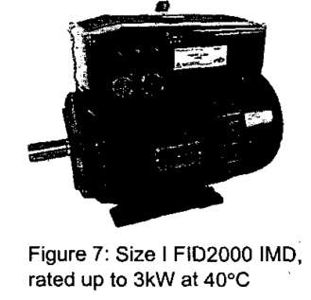
The idea of IMMD
The first idea of an Integrated Modular Motor Drive as we know of was brought forward in 2002.
Y Shakweh, G H Owen, D J Hall, H Miller
FKI Industrial Drives Ltd, UK, 2002
PLUG AND PLAY INTEGRATED MOTOR DRIVES
IMDs technology
Customer’s concerns, market status, future trends
Technical challenges to increase power ratings.
Today, IMD technology offers power output up to 7.5kW.

Slide 3
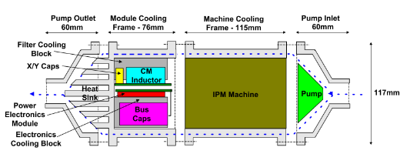
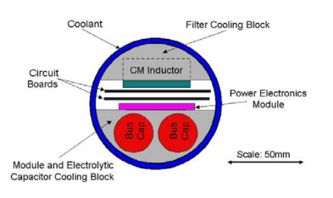
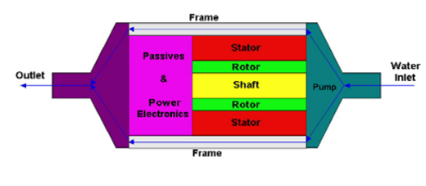
Early Years
University of Wisconsion-Madison, 2002
Nathan C. Harris, Thomas M. Jahns, Surong Huang (with Lipo)
Integrated Motor/Controller Drive for Automotive Water Pump Application
No hardware, No modularization.
500W, 42VDC, 5000rpm.
5 brushless machine topologies are discussed.Interior PM synchronous m/c is selected.
Six-switch PWM voltage-source inverter, power MOSFETs, integrated power electronics module (IPEM)
On Power Electronics side, physical layout, thermal management and EMI filter design are discussed

Slide 4
Early Years
University of Wisconsion-Madison, 2002
Nathan C. Harris, Thomas M. Jahns, Surong Huang (with Lipo)
Integrated Motor/Controller Drive for Automotive Water Pump Application
No hardware, No modularization.
500W, 42VDC, 5000rpm.
5 brushless machine topologies are discussed.Interior PM synchronous m/c is selected.
Six-switch PWM voltage-source inverter, power MOSFETs, integrated power electronics module (IPEM)
On Power Electronics side, physical layout, thermal management and EMI filter design are discussed

Slide 5
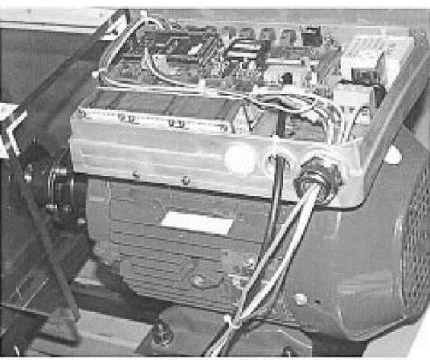
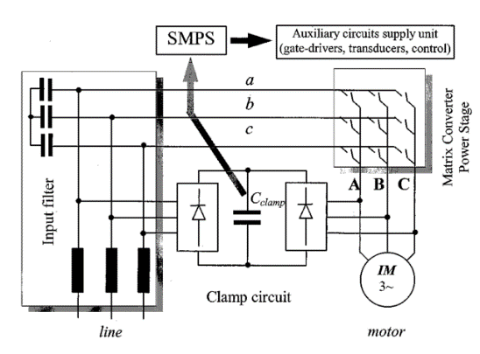
Aalborg University / Danfoss Drives
Christian Klumpner, Peter Nielsen, Ion Boldea, Frede Blaabjerg, Paul Thargersen
2002, Matrix Converter Motor (MCM) for Industry Applications
First integrated regenerative frequency converter motor for industry applications, based on a matrix converter topology.
4-kW matrix converter motor prototype
No modularization, IGBT-diode

Slide 6
Aalborg University / Danfoss Drives
Christian Klumpner, Peter Nielsen, Ion Boldea, Frede Blaabjerg, Paul Thargersen
2003, Converter Topologies the Next Generation of Integrated Motor Drives
ASD converter topologies (inverter is the same, rectifier and dc link/passive sides are different)
No modularity, no hardware
Evaluation of the Converter Topologies suited for Integrated Motor Drives

Slide 7
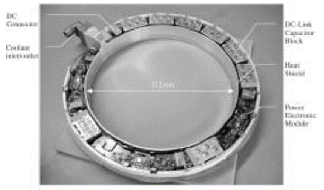
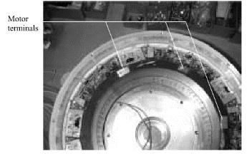
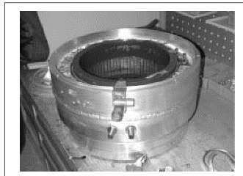
University of Stuttgart
J. Ranneberg, Y. Tadros, U. Schäfer
2004, Motor-Integrated Circular Converter for Hybrid Electric Vehicles
Motor-Integrated Circular Converter for Hybrid Electric Vehicles
Inserted in the stator housing around the end windings of the induction motor
200-400V, 50kW, IGBT, water cooled, No modularization, toroidal foil capacitor
Prototype

Slide 8
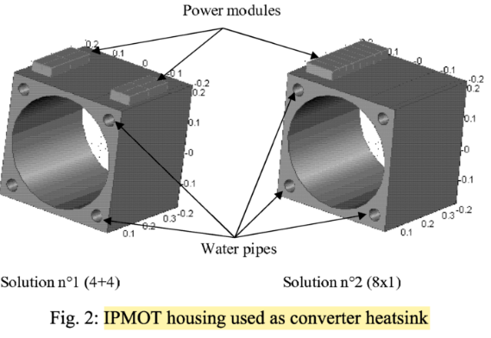
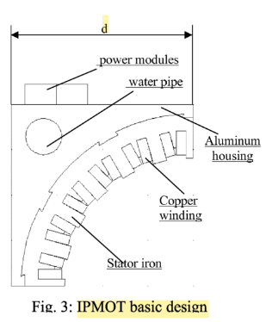
POLITECNICO DI TORINO, AACHEN UNIVERSITY
Francesco Farina, Daniele Rossi, Alberto Tenconi, Francesco Profumo, Stefan E. Bauer
2005, Thermal design of integrated motor drives for traction applications
25 kW SRM, water cooled square housing, IGBT based, Comsol simulations (2D FEM)
Integrated Propulsion MOTors (IPMOTs), pre-prototype is under construction

Slide 9
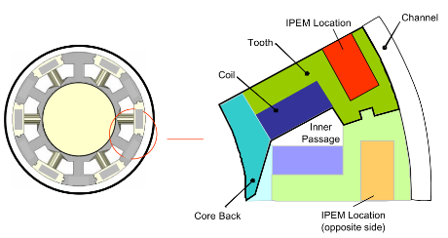
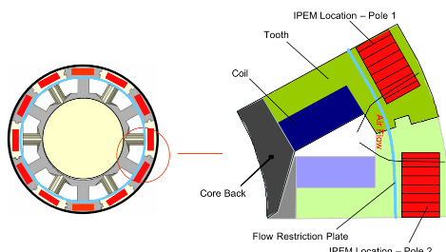
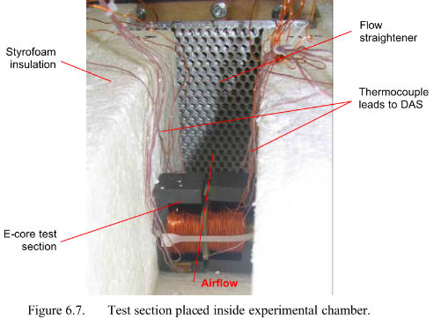
University of Wisconsion-Madison
Stephanie I. Mueller (MSc Thesis) with Professor Greg F. Nellis
2005, Model and Design of an Air-Cooled Thermal Management System for An Integrated Motor/Controller
Modular permanent magnet machine
Integrated power electronics module (IPEM)
Experimental verification with E cores?

Slide 10
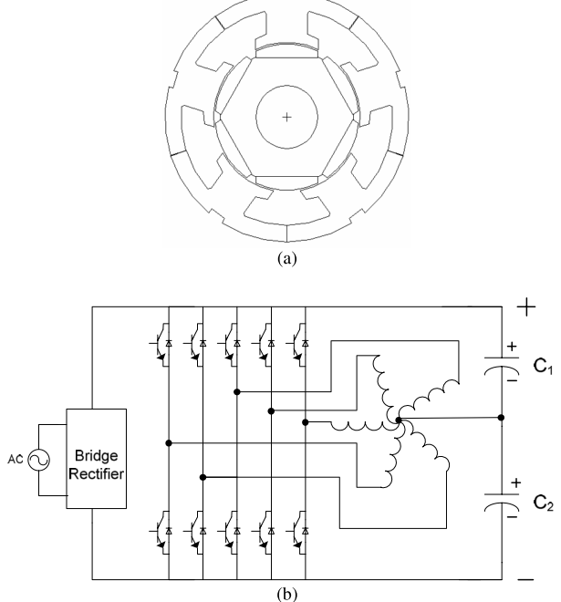
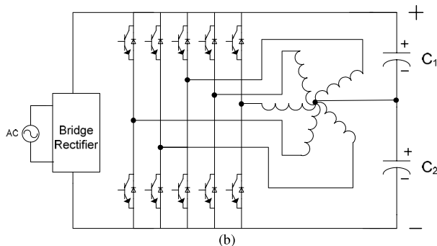
University of Wisconsion-Madison
Suman Dwari, Leila Parsa, and Thomas A. Lipo
2007, Optimum Control of a Five-phase Integrated Modular Permanent Magnet Motor Under Normal and Open-Circuit Fault Conditions
Simulation results, FEA, 5-phase
Integrated Modular Permanent Magnet Motor Drive (IMPMMD)
The torque pulsation has been decreased significantly

Slide 11
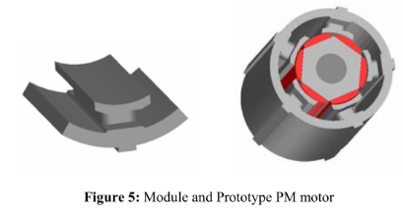
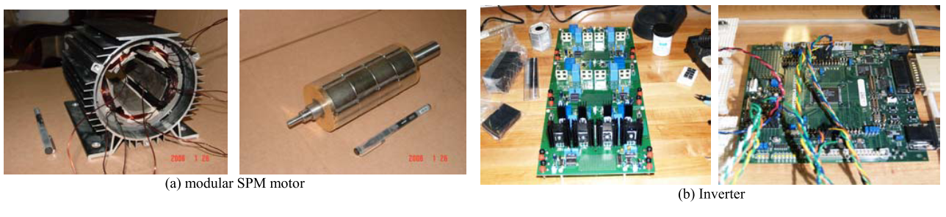
University of Wisconsion-Madison
Wen Ouyang, Nicholas Lemberg, Ruoping Yao*, T.A.Lipo
2007, A Novel Modular Permanent Magnet Drive System Design
Soft magnetic composites (SMC), flexible design options in 3D
Five-phase Modular SPM Motor, simulation results
The experiment setup work is still under way. The test results will be provided in the future report

Slide 12
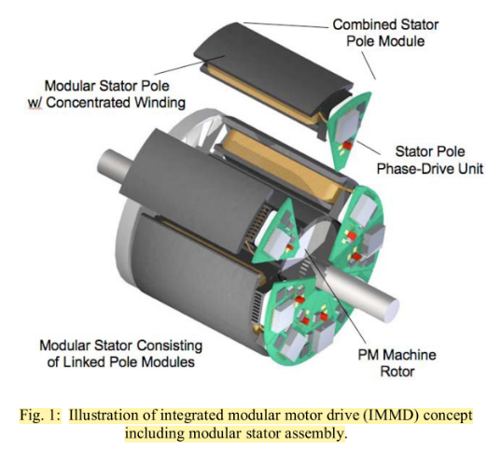
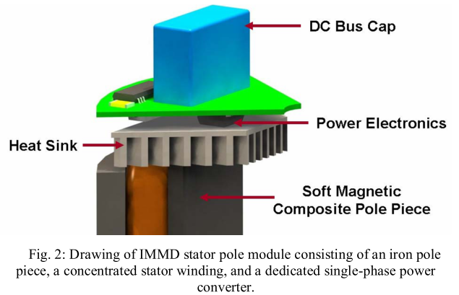
University of Wisconsion-Madison
N.R. Brown, T.M. Jahns, R.D. Lorenz
2007, Power Converter Design for an Integrated Modular Motor Drive
Five-phase machine, soft magnetic composite (SMC) material, six-pole surface PM rotor
2.7 kW, outer diameter is 120 mm, 400V dc bus, DC bus interconnections effect
Hard-switched half-bridge inverter phase-leg consisting of two IGBTs and anti-parallel diodes, 10kHz
DC bus capacitor, size requirement, experimental results with RL load, GMR sensors

Slide 13
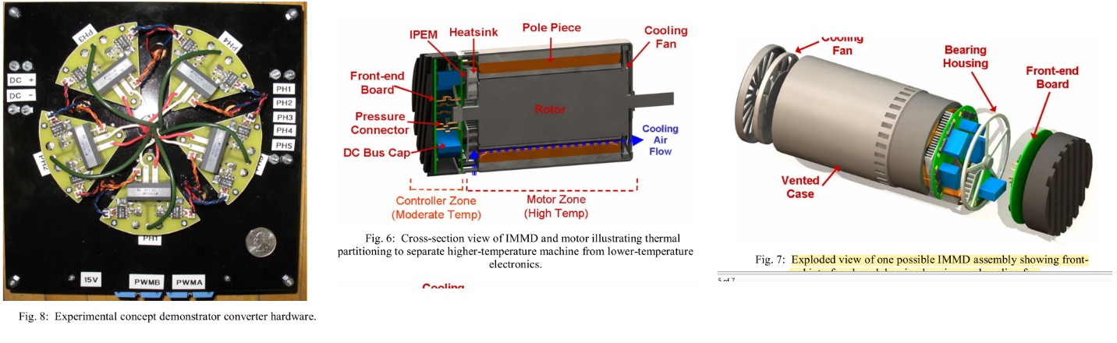
University of Wisconsion-Madison
N.R. Brown, T.M. Jahns, R.D. Lorenz
2007, Power Converter Design for an Integrated Modular Motor Drive

Slide 14
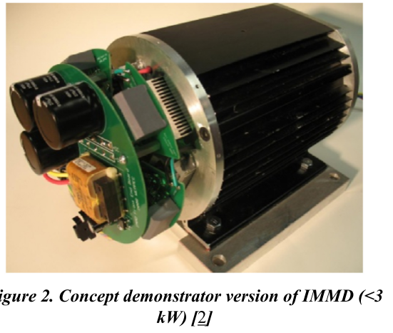
University of Wisconsion-Madison
Sykora, B. J., Jahns, T. M., and Lorenz, R. D
2008, Development of a Demonstrator Model of an Integrated Modular Motor Drive

Slide 15
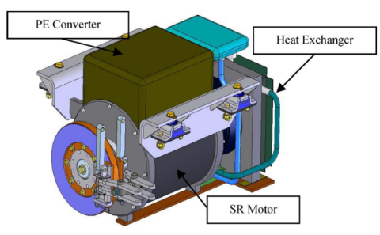
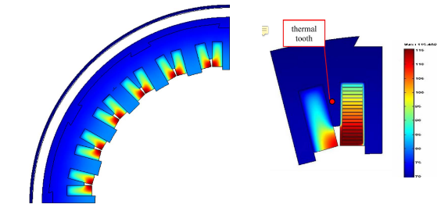
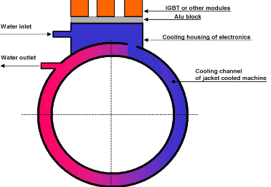
POLITECNICO DI TORINO, AACHEN UNIVERSITY
Alberto Tenconi, Francesco Profumo, Stefan E. Bauer, and Martin D. Hennen
2008, Temperatures Evaluation in an Integrated Motor Drive for Traction Applications
Liquid-cooled totally integrated drive unit Integrated Propulsion MOTor (IPMOT), 24-kW
Four-phase switched reluctance motor (SRM), IGBT based
Simulations (FEM) and thermal experimental setup

Slide 16
University of Wisconsion-Madison
Gilsu Choi, Zhuxian Xu and Ming Li, Shiv Gupta and Thomas Jahns1, Fred Wang, Neil A. Duffie, Laura Marlino
2011, Development of Integrated Modular Motor Drive for Traction Applications
Review of alternative concentrated winding PM machine configurations, Slot/pole combinations, SMC
Most promising controller architecture for providing a high-level of fault tolerance and robustness
A 10 kW phase-leg package using Si IGBT power devices combined with a 2-pass-tube coldplate is proposed that shows promise for holding the junction temperatures below 200°C with an ambient temperature of 150°C., IGBT switching experiments, thermal simulations
The results of these analytical and experimental studies have succeeded in setting the stage for developing a 10 kW preliminary prototype integrated motor drive during the coming year.

Slide 17
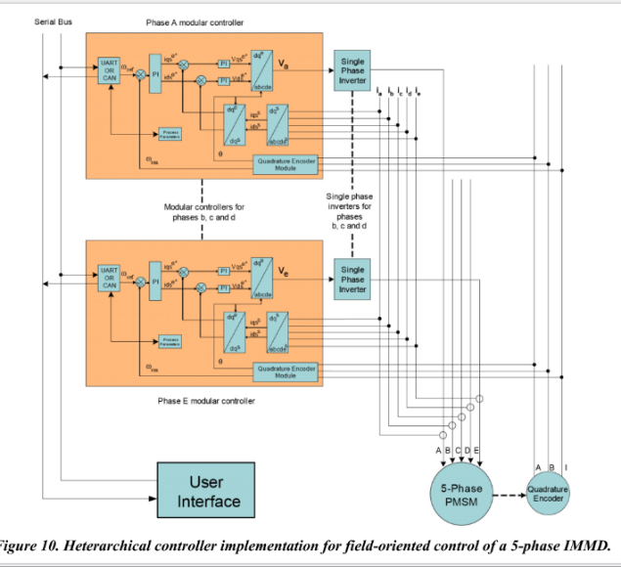
University of Wisconsion-Madison
Gilsu Choi, Zhuxian Xu and Ming Li, Shiv Gupta and Thomas Jahns, Fred Wang, Neil A. Duffie, Laura Marlino
2011, Development of Integrated Modular Motor Drive for Traction Applications

Slide 18
AACHEN UNIVERSITY
Martin D. Hennen, Markus Niessen, Christian Heyers, Helge J. Brauer, RikW. De Doncker
2012, Development and Control of an Integrated and Distributed Inverter for a Fault Tolerant Five-Phase Switched Reluctance Traction Drive
Five phase, Outer-rotor direct drive, 67kW, 750rpm, outer rotor 320mm, Ns/Nr 20/16
Railway traction applications, 400V dc link, 30A phase current, 3.4kW, 33 uF, 10kHz
The communication, as well as the generation of the switching signals, overcurrent protection, etc., is realized on a complex programmable logic device (CPLD) on each pole module
The predictive PWM- based direct instantaneous torque control (PWM-DITC), multiphase torque sharing algorithm
Fault tolerance analysis: torque ripple, unbalanced magnetic pull, vibration shapes

Slide 19
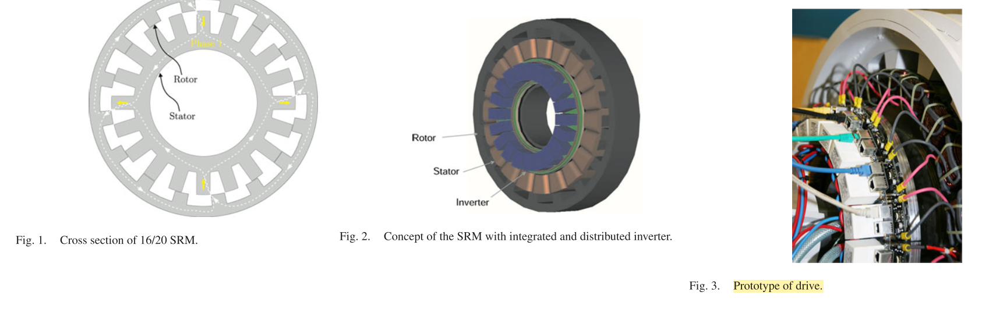
AACHEN UNIVERSITY
Martin D. Hennen, Markus Niessen, Christian Heyers, Helge J. Brauer, RikW. De Doncker
2012, Development and Control of an Integrated and Distributed Inverter for a Fault Tolerant Five-Phase Switched Reluctance Traction Drive

Slide 20
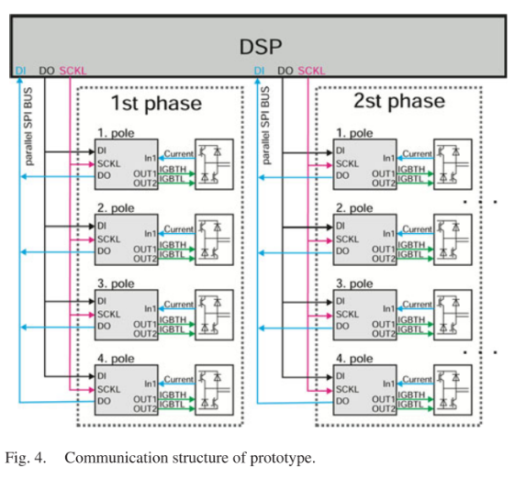
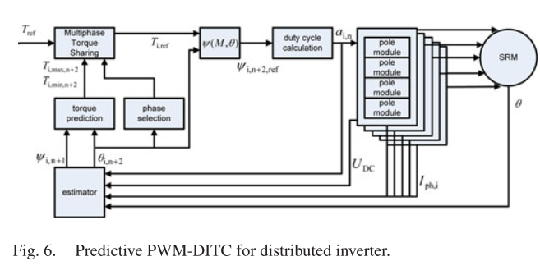
AACHEN UNIVERSITY
Martin D. Hennen, Markus Niessen, Christian Heyers, Helge J. Brauer, RikW. De Doncker
2012, Development and Control of an Integrated and Distributed Inverter for a Fault Tolerant Five-Phase Switched Reluctance Traction Drive

Slide 21
University of Wisconsion-Madison
Adam Shea (Master Thesis), T.M. Jahns
2014, Hardware Integration for an Integrated Modular Motor Drive Including Distributed Control
This was the first IMMD prototype unit that included a dedicated controller in each module (Second generation)
18kW (peak), 6-phase IMMD demonstrator unit for a traction drive
Heterarchical distributed control strategy
Half-bridge inverter phase-leg for each phase with two discrete 600V IGBTs in TO-247 packages. The nominal dc bus voltage is 325 Vdc.
Cooling for each phase-leg module is accomplished using an off-the-shelf copper pin-fin waterblock designed for graphics card cooling.
10kW surface six-phase variant of a three-phase fractional-slot concentrated winding permanent magnet (PM) synchronous machine (12/10).
The presence of two wyes makes it possible to shut one down one three-phase inverter and continue

Slide 22
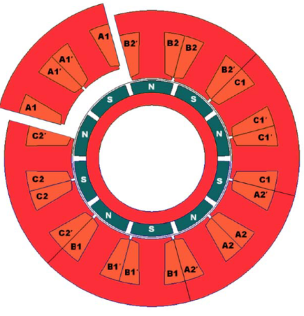
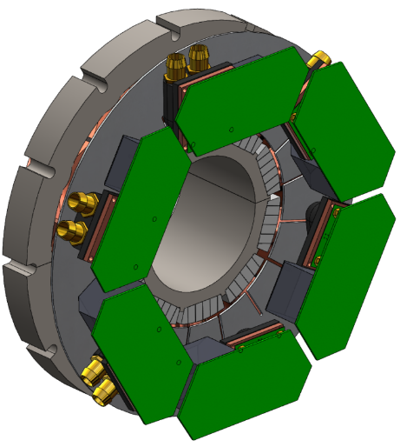
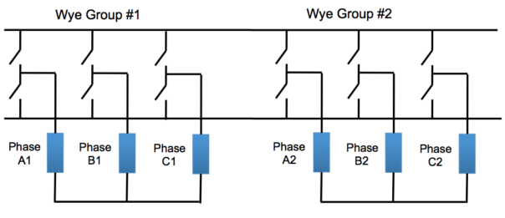
University of Wisconsion-Madison
Adam Shea (Master Thesis), T.M. Jahns
2014, Hardware Integration for an Integrated Modular Motor Drive Including Distributed Control
Test:
Constant-V/Hz operation at 200Hz (2400r/min) under no-load conditions
A basic sine-triangle PWM algorithm is used for the voltage modulation with a switching frequency of 20kHz and a modulation index value of 0.95.
The drive is operating with a reduced dc link voltage of 110V
Current and voltage waveforms, hall effect sensor frequency test

Slide 23
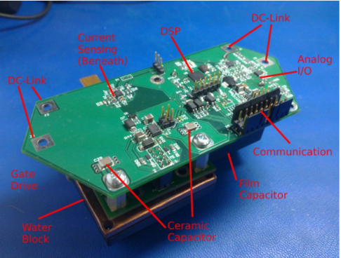
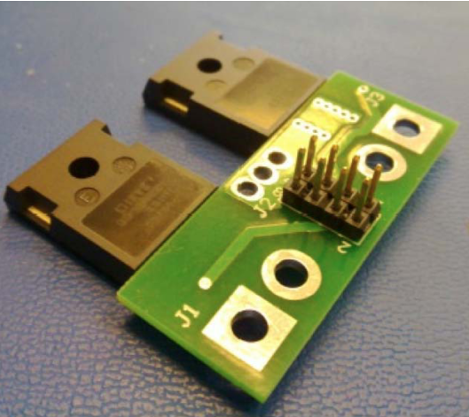
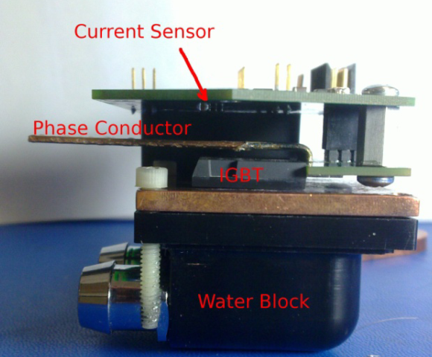
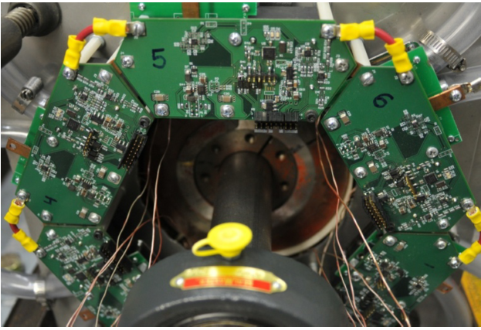
University of Wisconsion-Madison
Adam Shea (Master Thesis), T.M. Jahns
2014, Hardware Integration for an Integrated Modular Motor Drive Including Distributed Control

Slide 24
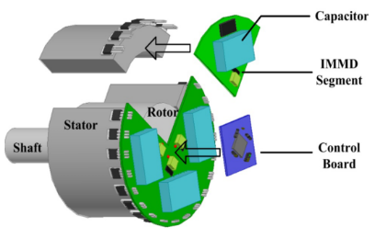
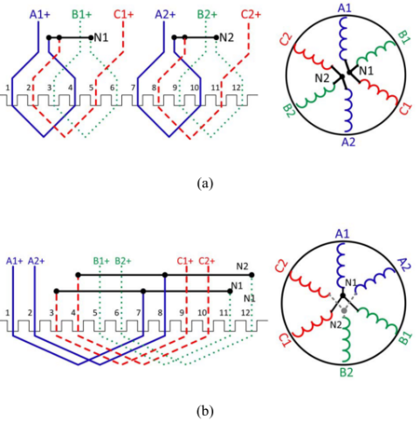
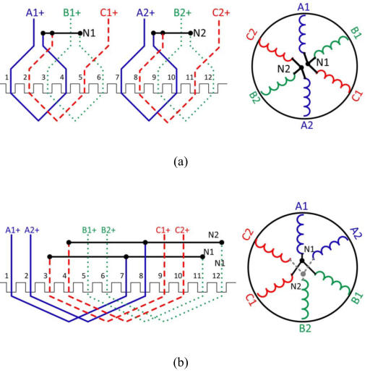
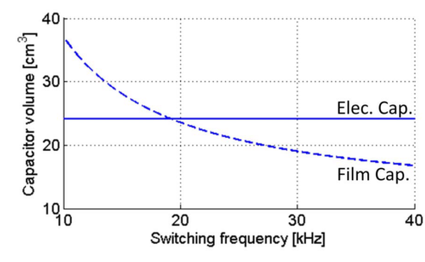
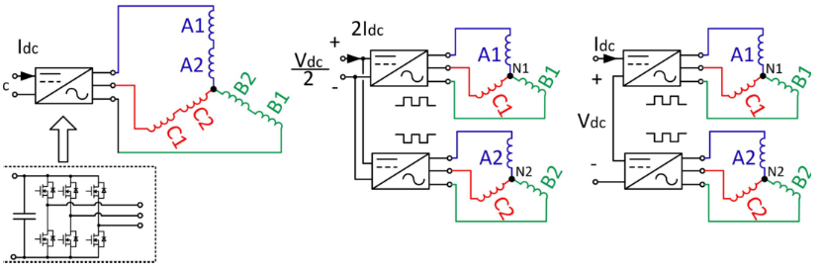
University of Wisconsion-Madison
Jiyao Wang, Ye Li, Yehui Han
2013, Evaluation and Design for an Integrated Modular Motor Drive (IMMD) with GaN devices

Slide 25
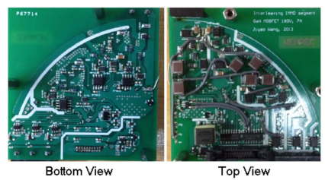
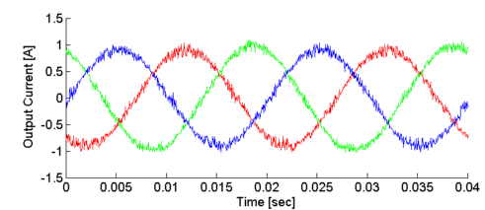
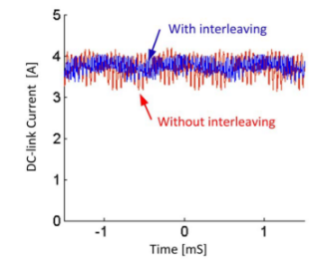
University of Wisconsion-Madison
Jiyao Wang, Ye Li, Yehui Han
2013, Evaluation and Design for an Integrated Modular Motor Drive (IMMD) with GaN devices
Series-connected inverter segments, wide bandgap 200V GaN MOSFETs
Eliminating inverter heat sink and optimizing the choice of DC-link capacitors, interleaving
Keep the height of capacitors within 1 inch, capacitor selection and comparison (AEL, Film, Ceramic)
Active DC link balancing
Experiment: 180Vdc, 7Arms, 36uF, 0.6inch height, 3 inch radius, RL load test

Slide 26
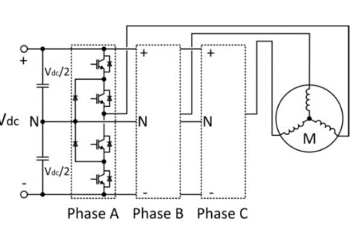
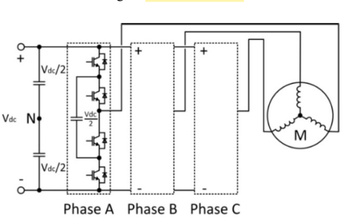
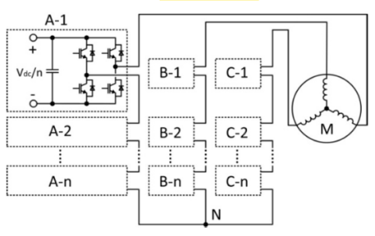
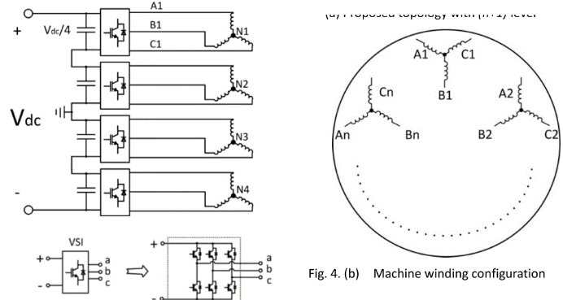
University of Wisconsion-Madison
Jiyao Wang, Ye Li, Yehui Han
2014, A New Concept of Multilevel Converter Motor Drive with Modular Design and Split Winding Machine

Slide 27
University of Wisconsion-Madison
Jiyao Wang, Ye Li, Yehui Han
2014, A New Concept of Multilevel Converter Motor Drive with Modular Design and Split Winding Machine
Significant reduction in component quantity. does not require any extra capacitors, diodes or isolated voltage sources.
Unlimited flexibility and performance optimization, can accommodate a wide range of voltage levels and power ratings, allowing for the use of low-voltage, less-expensive devices.
Compatibility with different systems. The proposed topology can be supplied by either a single dc source, or several dc sources to power each module.
Modular design. All inverter modules are identical. Manufacturing cost reduction, faster product development, easy maintenance, and simple construction. The proposed topology has identical gate signal commands for each module (with a phase-shift for interleaving)
Release of insulation burden and extended service life. The common mode voltage and differential mode output voltages on insulation layers are reduced to to Vdc/n.
Reduction in capacitor size. The capacitor size can be further reduced by the interleaving technique.
Better fault tolerance. The proposed topology has access to the voltage and current of each machine winding enabling detection of machine faults quickly and accurately through measurement of winding voltages.
The disadvantage of the proposed topology is the increased number of machine leads

Slide 28
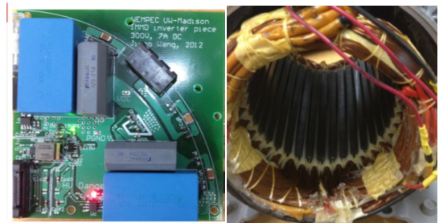
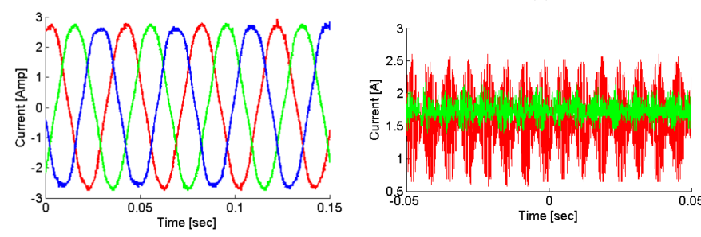
University of Wisconsion-Madison
Jiyao Wang, Ye Li, Yehui Han
2014, A New Concept of Multilevel Converter Motor Drive with Modular Design and Split Winding Machine
Machine split winding, Gate signal interleaving, Voltage balancer. PSD söylememiş ???
Simulation: 2 modules, MATLAB/Simulink, 200Vdc, 30kHz, 1mF each, 2 A Iq
Experiment: 2 modules, 1.5kW, m/c, 200Vdc, 25kHz, 54uF each, 750rpm, 36 slot induction
In experiment, a 3-lead, 3-phase, 4-pole induction motor is rewound into a 6-lead 3-phase motor

Slide 29


University of Wisconsion-Madison
Yehui Han
2014, Design, modeling, and control of multilevel converter motor drive with modular design and split winding machine
Experiment: RL load
Two inverters, 150V, 3A each, 36uF, inverter radius: 3 inch, converter height: 0.6 inch
%35 reduction in the DC link current ripple
Motor ile de test yapılmış (rewound induction)

Slide 30


University of Wisconsion-Madison
Yehui Han
2014, Design, modeling, and control of multilevel converter motor drive with modular design and split winding machine

Slide 31
http://power.eee.metu.edu.tr/
Mesut Uğur
mugur@earsis.com
https://blog.metu.edu.tr/ugurm/

